Slide 1


Blackjack Game Development
Sprint 2 Review and Demo
Project Team
Date
Nepal National Team
5 November 2024

Slide 2




Sprint 1 Recap: Laying the Foundation
Key Objectives
Core Game Logic
To develop a simple, secure, and engaging Blackjack game with smooth gameplay and a clean interface.
Established basic rules for card dealing, calculating hand values, and determining Blackjack.
Functional and Non Functional Requirement
Functional: login, registration, and game logic.
Non-functional: performance, usability, and reliability.

Slide 3


Sprint 2 Goals and Achievements
Player Actions
Login and Registration
Functional "Hit," "Stand," and “Restart" buttons integrated with the game flow.
Implemented login and registration system using firebase as a database

Slide 4
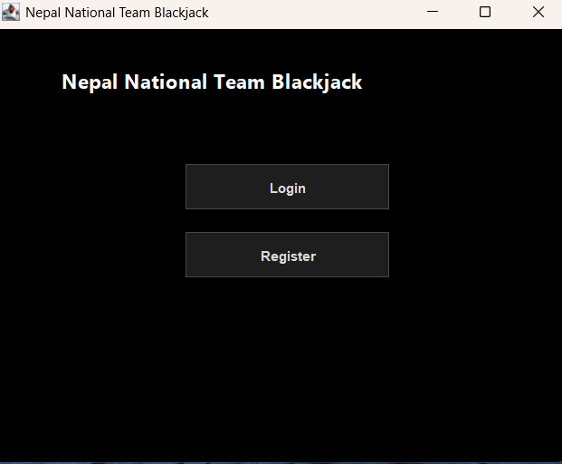
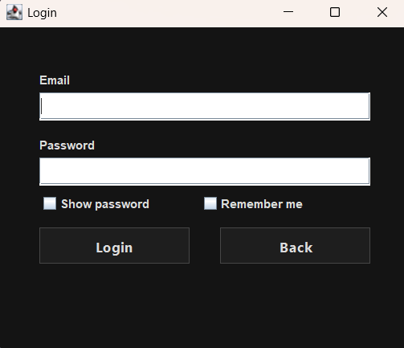
Feature Demonstration: Live Gameplay Flow
Walkthrough Highlights

Slide 5
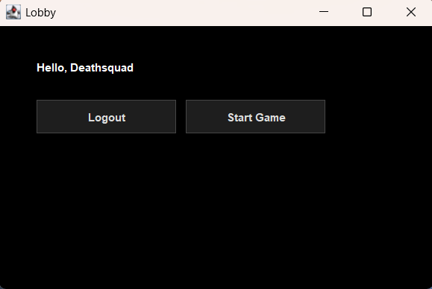
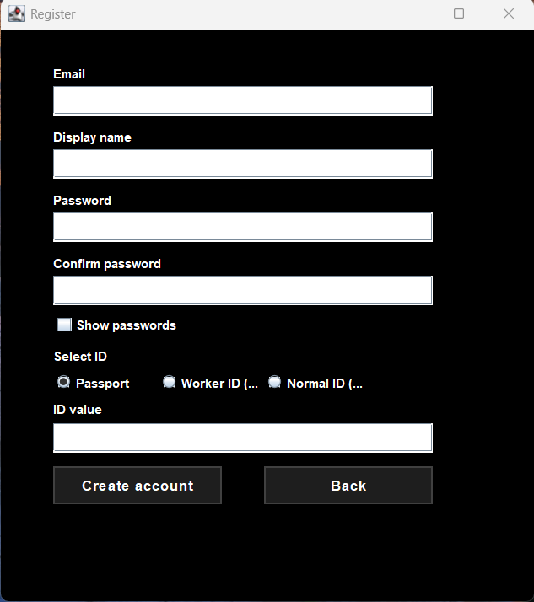
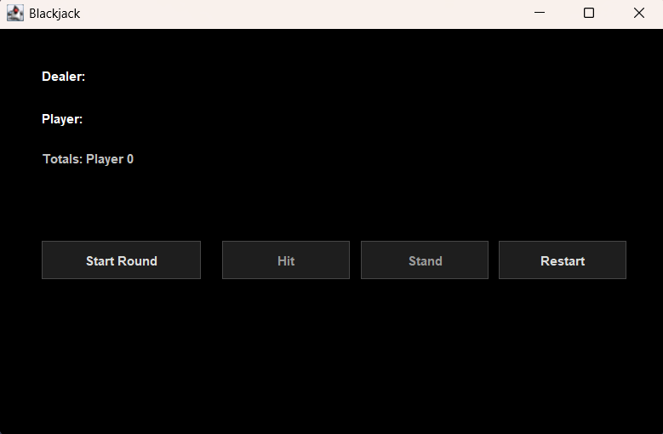
Feature Demonstration: Live Gameplay Flow
Walkthrough Highlights

Slide 6

Technical Implementation Details
Modular Frontend
State Management
API Integration
Utilizing React components for isolated UI features (e.g., Betting Widget, Hand Component) to ensure maintainability.
Centralized game state using Redux/Context to manage real-time updates for bets, hands, and dealer status.
Optimized REST API endpoints for secure transaction handling (bet placement, win/loss recording) and minimal latency.
Player Action
API Call
Server Logic
Database Update

Slide 7

Challenges Faced & Solutions
Challenge: Firebase implementation
Ensuring email authentication and proper configuration of Firebase for our needs
Solution: Going thru documentation
Since any of us was used to Firebase we had to learn how to properly use it from scratch

Slide 8





Next Steps: Sprint 3 Plan
Insurance & Surrender
Implement advanced player options: taking insurance against a dealer's Ace and the option to surrender.
Persistent Bankroll and Chips
Integrate a persistent user bankroll/wallet that updates accurately after every round and persists across sessions. Which will be implemented after the betting amount per hand .
Database consistency
Due to the fact that every user will have a wallet, we need to limit database writes and reads to the latest version of the app, which will help maintain data consistency and give the app a more professional look.
Handling Splits
Advanced feature implementation for splitting pairs and managing multiple hands simultaneously.

Slide 9



Conclusion: Ready for Launch
Core Functionality Complete
Sprint 2 successfully delivered the interactive betting and complex gameplay mechanics (login, hit , stand).
Team Performance
Excellent collaboration and proactive problem-solving ensured all major features were delivered on time.
Next Milestone
Sprint 3 will focus on financial persistence and a final polish for a full product release candidate.
Thank you for your time and feedback!

